Slide 1
The 15th LASU VIRTUAL PUBLIC LECTURE
ICT in The Post COVID-19 world: The Realities, Challenges and Opportunities

Slide 2
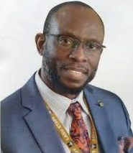
Chief Host
Professor Olanrewaju A. FAGBOHUN PhD, SAN, NPOM
Senior Advocate of Nigeria
National Productivity Merit Award Winner, 2019
Professor of Environmental Law
Vice-Chancellor
Lagos State
University

Slide 3
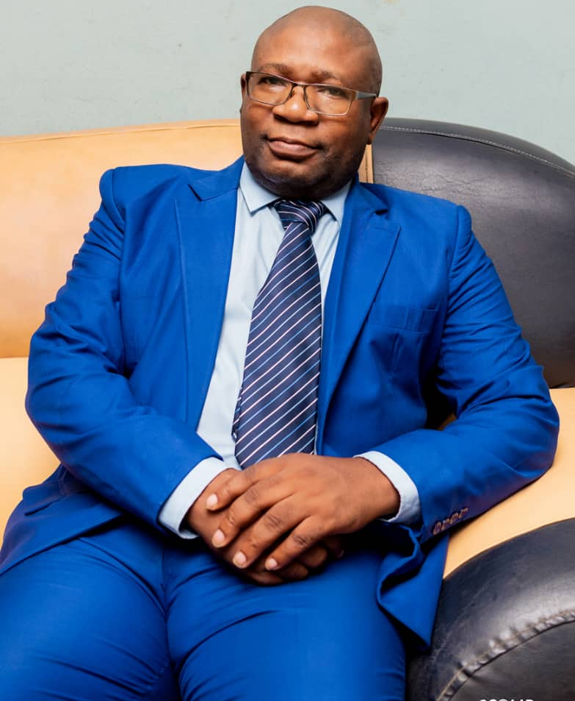
ICT in The Post COVID-19 world: The Realities, Challenges and Opportunities
Professor Benjamin Aribisala
Professor of Computer Science
Director, Directorate of ICT
Member of Governing Council, LASU
Immediate past Dean of Science, LASU

Slide 4
Introduction
It is no more news that COVID-19 is real and it kills
Developed world is already in wave 2, not getting better
It seems things are much better in Nigeria
It is generally believed that COVID-19 will soon be over
Although, we are still required to comply with covid-19 protocols
COVID-19 has affected our lifestyles, economy, education, etc
Our focus today is on the challenges, realities and opportunities brought by covid-19 as it relates to ICT
Notes:
Globally, about 59 million cases and about 1.4 million death
Nigeria, about 66,000 cases and 1000 death

Slide 5
Speakers and Topics

Slide 6
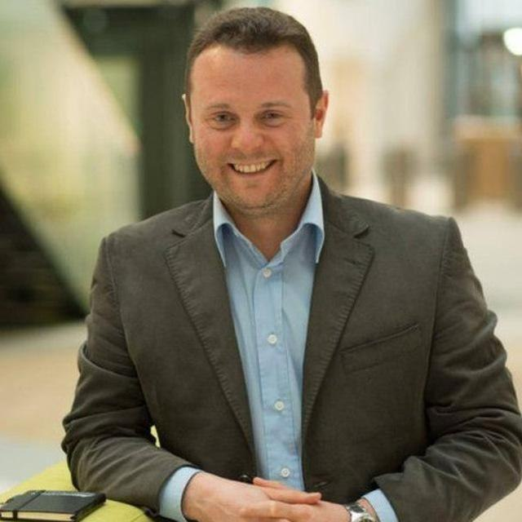
1
Prof. Manuel Mazzara
Education after Covid-19: The Role of ICT
Professor of Software Engineering
Vice Dean of International Relations
Innopolis University, Russia
Previously worked in Newcastle University, UK

Slide 7
2
Chief Toyin Oloniteru
The Realities of ICT in the post Covid-19 World.
CEO Spindle Group
Professor of Health Education
Specialist in Community and Environmental Health
Director of Sandwich Program

Slide 8
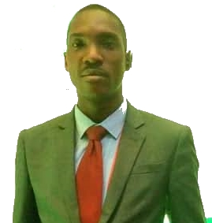
3
Mr. Bolaji Alaba Ojediran
The Challenges and Opportunities of ICT in the post Covid-19 World
Principal System Analyst, Directorate of ICT, LASU
Certified Forensic Examiner
An Expert in Web Development and Digital Marketing

Slide 9
Presentation Guide
Each of the speakers is assigned 15 minutes
By invitation of the moderator, panelists will speak in this order ;
Prof. Manuel MAZZARA
Chief Toyin OLONITERU
Mr. Bolaji OJEDIRAN
All participants will be muted
Use chat to ask questions
Questions and answers will be addressed in relevance to panelists
For the purpose of attendance, make sure your real name appears on your device.
To check, click on participants at the bottom right of zoom, then look for your name, if it is not there then you need to rename your device to your real name

Slide 10
Happy Listening

